Slide 1

Name : Yash Chatniwala
Shubham Mane
Enrolment No :
Yash : EN12025087816
Shubham : EN12026088689
Batch code : DA51
Mentor : Jaya Pandey
CAPSTONE PROJECT
Football Analytics

Slide 2
Introduction:
It is very hard for football teams and managers to use all the numbers and data from matches to make good decisions. There is too much information about players, matches, and competitions, and it is not easy to find what really matters. This project aims to organize, analyze, and explain this football data using charts, tests, and models, so it becomes simple for clubs, managers, and fans to find important patterns and make better choices.
Business Objective :
Analyze how player market values relate to their on-field performance, such as goals, assists, and minutes played
Creating easy-to-understand dashboards for coaches to monitor player and team performance across competitions and seasons
Identify consistent top performers versus underperformers to help in future team selection or transfers.
Study referee influence by checking if certain referees are linked to more fouls, cards, or penalties in matches.
Build simple models or forecasts to predict future team or player performance based on recent data.

Slide 3




01
Introduction
02
Focus Area
Tools Used
03
Data Cleaning
04
Descriptive Analysis
Capstone Journey : Step by
Step
05
EDA
06
Statistical Testing
07
Model Building & Prediction
08
Interpretation & Insights
09
Conclusion & Recommendations
Notes:
Excel:
Used for initial Quick Data Summarizing ,data analysis and exploration.
MySQL:
Utilized for data connection, storage, and creating database triggers.
Data Querying and Efficient handling of large datasets
Tableau:
Employed for interactive visualization and dashboard creation.
Dynamic reports and insights communication.
Python:
Data preprocessing
Statistical hypothesis testing
Machine learning models
Prediction tasks.

Slide 4
Data Cleaning and Organization Summary:
Data Understanding
Data Merging
Data Cleaning
Data Modification
Initially There was 57 Columns and After data cleaning and preprocessing, 35 columns remained
Notes:
Data Understanding
Checked all raw files (like player stats and match details) to see what information was available.
Identified useful columns for analysis such as goals, assists, minutes, and player identities.
Data Merging
Joined files together using unique player and match IDs.
Combined features so every player-record included all stats needed for analysis.
Data Cleaning
Removed extra columns and duplicate rows to keep the dataset tidy.
Fixed missing and wrong data by filling gaps with “NA” for categories and median values for numbers.
Data Preprocessing
Changed column types so numbers, dates, and text would work in analysis tools.
Made new calculation columns (like Goals per 90) and saved the final data for Tableau dashboards.
Data Description :
This data belongs to a cleaned Football player and Match dataset featuring key statistics, attributes, and event records across various competitions.
Player Identification: Unique player ID, name, and nationality.
Market Value: market worth of players and Highest Market values of players in euros.
Position: The role of a player on the field, such as goalkeeper, defender, midfielder, or forward, which defines their primary responsibilities during the match.
Match Details: Date, competition type.
Performance Metrics: Goals, assists and fouls.
Referee Information: Referee assigned to each match, with data on cards issued and fouls called.
Contract and Transfer Data: Information on player contracts for valuation analysis.
Team and Manager Info: Lists home and away club names and manager names.
Venue Info: Includes stadium name and attendance count.

Slide 5
Focus Areas Of Football Data Analysis
6
Competition & Referee Analysis
5
1
Performance Analysis
Player Attributes & Demographics
Focus Areas
4
2
Team Comparison
Player Profile
& Market
Value
3
Attendance
& Stadium Analysis
Notes:
Excel:
Used for initial Quick Data Summarizing ,data analysis and exploration.
MySQL:
Utilized for data connection, storage, and creating database triggers.
Data Querying and Efficient handling of large datasets
Tableau:
Employed for interactive visualization and dashboard creation.
Dynamic reports and insights communication.
Python:
Data preprocessing
Statistical hypothesis testing
Machine learning models
Prediction tasks.

Slide 6
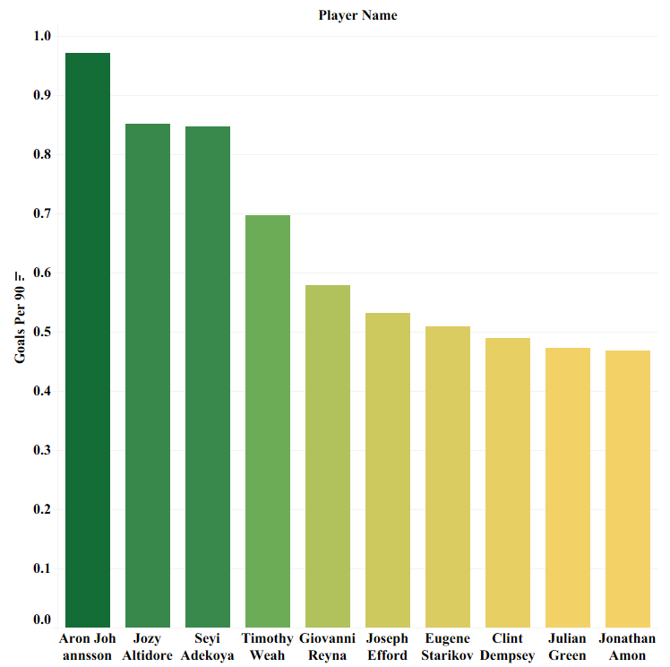
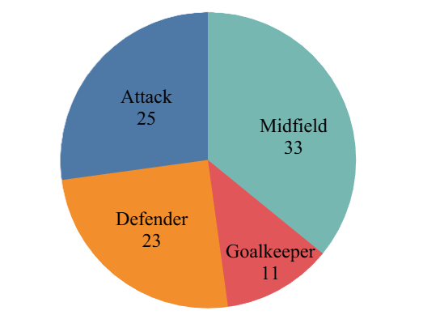
1
Descriptive Analysis
Performance Analysis
Top 10 Players by Goals Per 90 Minutes ( Per Match )
Player Distribution by Position
Interpretation :
The chart highlights the most efficient goal scorers, showing that Aron Johannsson leads in goals per 90 minutes, with others like Jozy Altidore and Seyi Adekoya also performing strongly. Players at the top consistently score more goals relative to their time played.
Interpretation :
This pie chart displays the count of unique players in each playing position. The largest segment is for midfielders (33), followed by attackers (25), defenders (23), and goalkeepers (11), indicating midfielders are the most common position in the dataset and goalkeepers the least.
Notes:
Descriptive Analysis :
Summarized the Data : Found basic numbers like totals, averages, highest and lowest values to quickly understand key points (like how many players, goals, clubs, market values, etc.).
Showed Everything in Charts : Created clear visuals - like bar charts, pie charts, and line graphs - so patterns and differences are easy to spot for everyone.
Looked for Patterns : Checked which players or clubs do best and when, spotted any unusual trends or standout seasons, and saw where there are sudden spikes or drops.
Made it Useful for Decisions : These summaries and charts help coaches, managers, or fans make smarter choices—for example, focusing on successful players, strong clubs, or areas needing improvement.
Compared Different Groups: Broke down the data by categories (like player position, club, season, or competition) to see how different groups perform and discover what makes some better than others.
Conclusion :
Descriptive analysis is the first and most important step for finding value in data, as it helps everyone see what is really happening.

Slide 7
Probability Analysis of Goals and Assists :
Probability of Assisting: About 7.36% of match entries show a player making at least one assist.
Probability of No Goals and No Assists: In 82.56% of matches, players neither scored nor assisted.
Probability of Goals or Assists: Players contributed to scoring (either goal or assist) in 17.44% of matches.
Conditional Probability of Assist Given Goals: When a player scores, there is about a 13.4% chance they also provide an assist in that match.
Conditional Probability of Goals Given Assist: When a player assists, there is about a 21.17% chance they also score a goal in the same match.
Interpretation:
Most players do not directly contribute to goals in many matches.
Some players both score and assist, but it’s less common.
Knowing these probabilities helps understand player performance patterns and their likelihood of contributing in different ways.
Notes:
Probability of Assisting (p_assist):
This shows how often a player makes at least one assist in a match, e.g., 7.36% times a player assisted.
Probability of No Goals and No Assists (p_no_goals_no_assist):
This shows how often players neither scored nor assisted in a match, e.g., 82.56% of match performances had no goals or assists.
Probability of Goals or Assists (p_goals_or_assist):
This is how often a player either scored or assisted (or both) in a match, indicating how often players contributed to scoring, e.g., 17.44% of the time.
Conditional Probability of Assist Given Goals (cond_assist_given_goals):
Among those matches where a player scored, this shows how often they also assisted. This tells you the chance a goal scorer also helped another goal, e.g., 13.4% of goal scorers also assisted.
Conditional Probability of Goals Given Assist (cond_goals_given_assist):
Among those matches where a player assisted, this shows how often they also scored. This tells you the chance an assister also scored themselves, e.g., 21.17% of assisters also scored.
These probabilities and conditional probabilities give insight into player performance patterns: whether players tend to score, assist, or do both in matches.

Slide 8
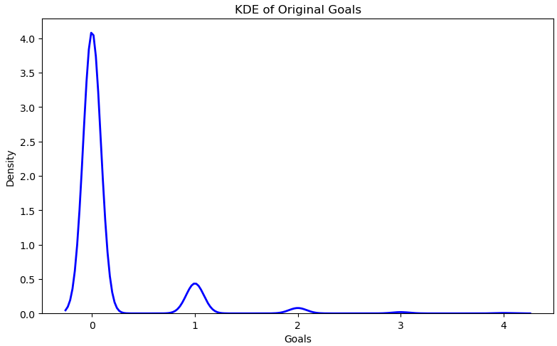
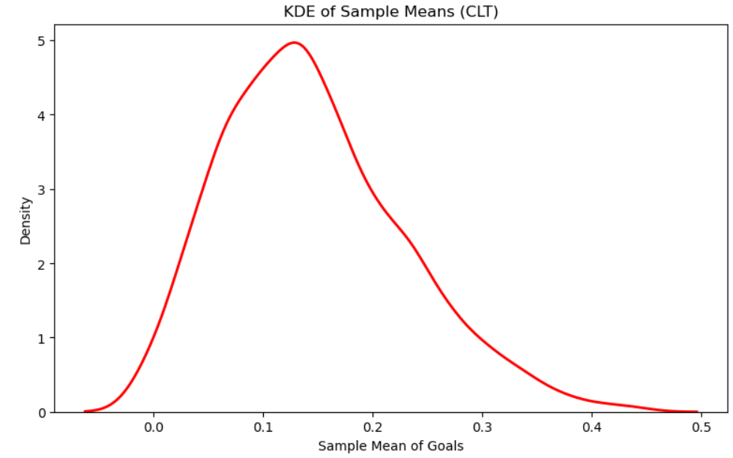
Central Limit Theorem
Interpretation of Original Goals KDE:
This curve shows the distribution of the actual goals scored by each player in the dataset. The shape is not bell-shaped; it is sharp and right-skewed, with most values at zero or close to zero. Which shows most players score 0 or 1 goal.
Interpretation of KDE of Sample Means :
This curve shows the distribution of the mean goals from many random samples (of size 30). The shape is bell-shaped (nearly normal), even though the original was highly skewed. This shows the Central Limit Theorem in action: the distribution of sample means will be normal if the sample size is large enough.
Notes:
In easy language, the KDE plot of sample means (CLT) means:
We took many small groups (samples) from the whole dataset and calculated the average goals in each group.
Then, we made a graph of all those averages.
This graph becomes bell-shaped (normal curve) even if the individual player scores are very uneven.
Why is this useful? Because averages are easier and more reliable to work with than raw data, especially when data is messy. For example, if you want to predict a player's average goals per game, knowing this bell curve helps you understand the variability and uncertainty of your estimates in a predictable way.
So, CLT lets you trust averages from samples to represent the whole population and use standard statistics for predictions and decisions.

Slide 9
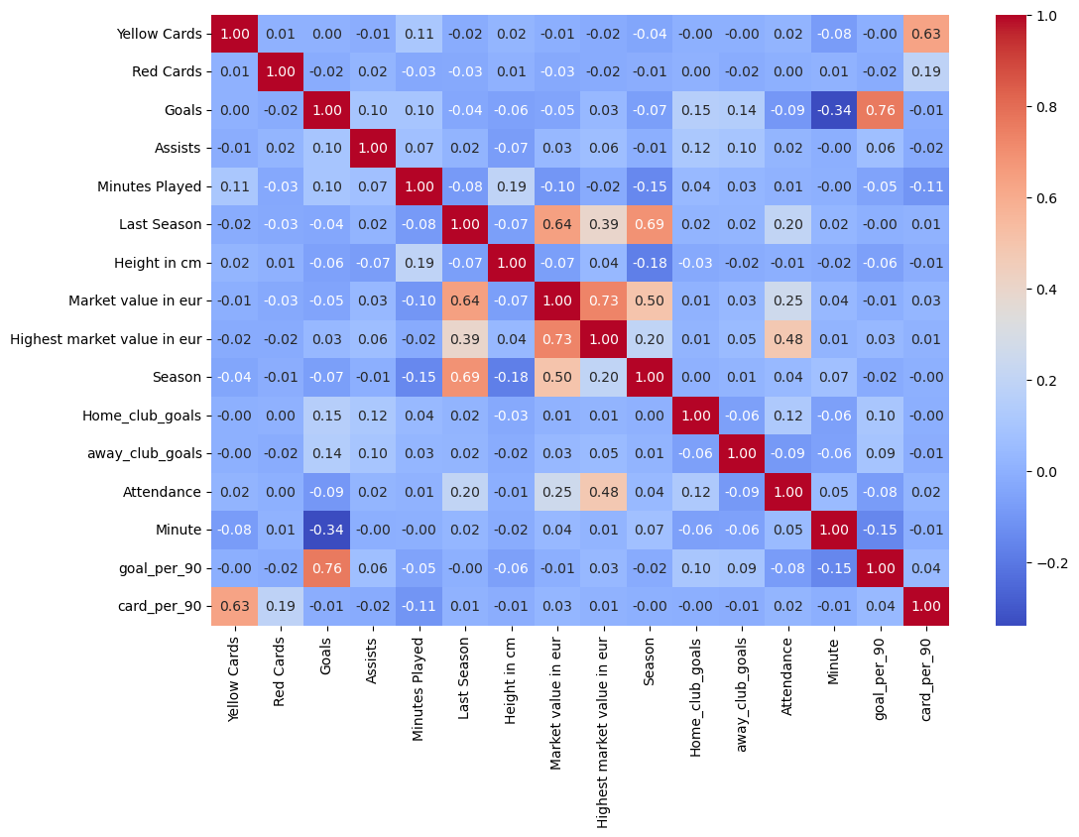
Linear Regression Model For Predicting Goals :
Based on correlation analysis and model testing, the top features for predicting player goals are:
    Assists
    Minutes Played
    Home Club Goals
    Away Club Goals
    Goals per 90 minutes
Building and Testing the Predictive Model :
  Model Performance:
    Mean Absolute Error (MAE): 0.13
    Mean Squared Error (MSE): 0.05
    R2 Score: 0.71
    RMSE: 0.23
  These scores show the model predicts well and can be trusted for analysis.

Slide 10
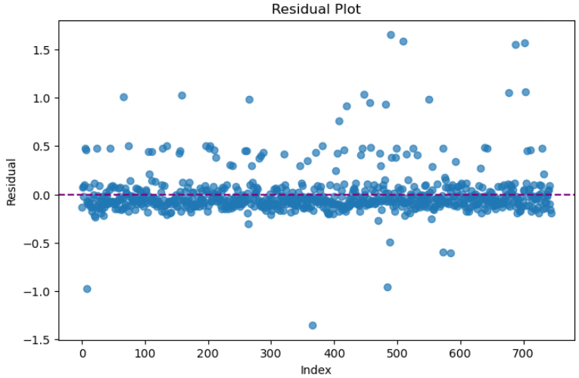
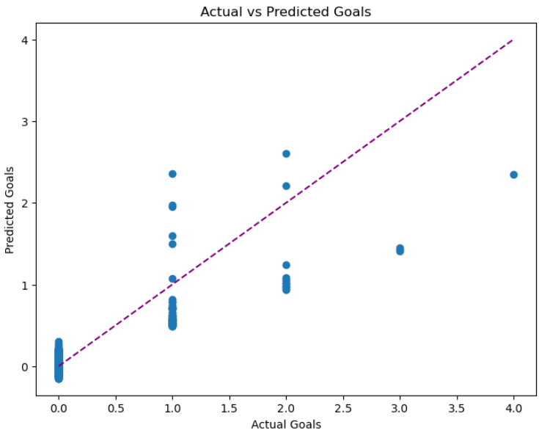
Residual plot & Actual vs Predicted Goals :
Residual Plot :
The residual plot displays errors; most dots are close to zero, meaning our predictions are usually on target.
Each dot shows one prediction error; points close to the Purple line mean our model predicts well.
Actual vs Predicted Goals :
The actual vs predicted chart shows our model predicts football goals mostly well, with points close to the diagonal line.
When the actual goals get higher, the predictions sometimes miss and spread out more.
Overall, both charts show our model predicts goals well and the errors are random, which means our model is good.

Slide 11
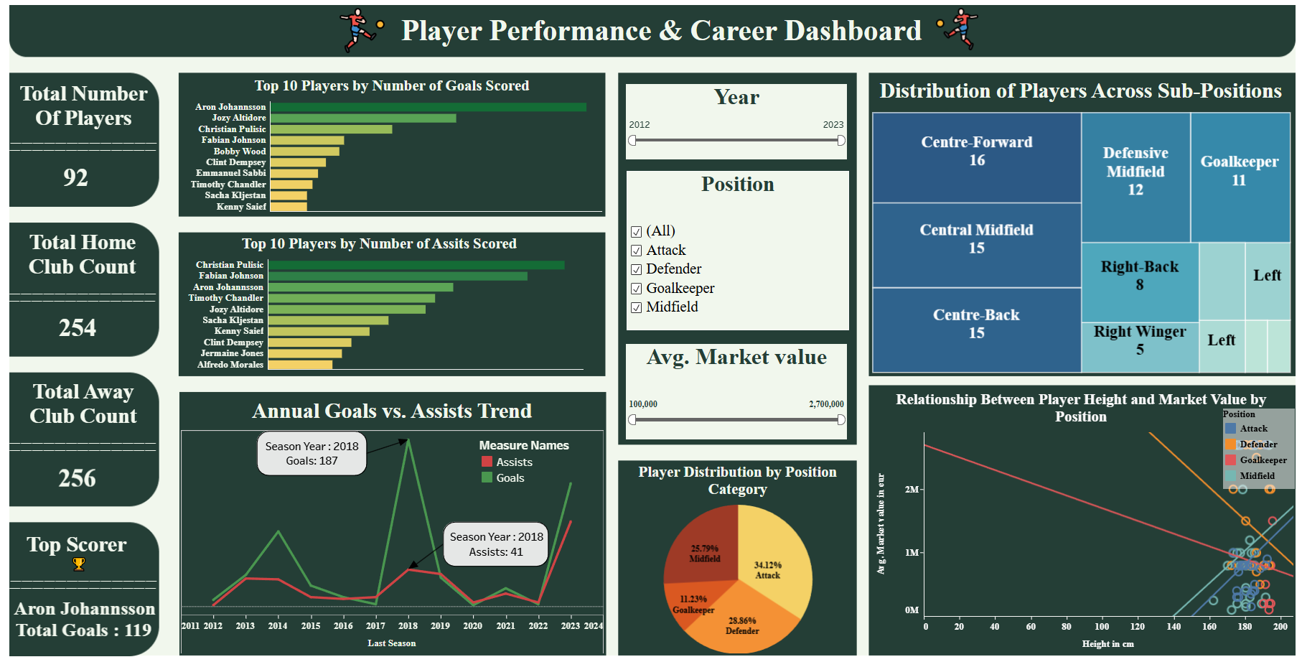
Click Here

Slide 12
Hypothesis Testing
2
Player Profile
& Market
Value
Null Hypothesis (H0):
  There is no significant difference between the sample mean and population mean of Market value.
Z-Test for Market Value:
  Z-statistic = 0.26,
  P-value = 0.85 (> 0.05)
Interpretation:
  Accepted H0. The sample market value is consistent with the population mean.
Null Hypothesis (H0):
  There is no significant difference between the sample mean and population mean of Assists.
T-Test for Assists:
  T-statistic = -2.81
  P-value = 0.27 (>0.05)
Interpretation :
  Accepted H0. The sample mean for assists is significantly same from the population mean.
Conclusion: Market value predictions are consistent with the overall population, and assists data also show no significant difference from the population mean, supporting the reliability of further analysis.

Slide 13
Linear Regression Model for Predicting Player Market Value
Based on correlation analysis and model testing, the top features for predicting player market values are:
    Attendance
    Season
    Last Season
    Highest market value in euro
Building and Testing the Predictive Model :
  Model Performance:
    Mean Absolute Error (MAE): 0.45
    Mean Squared Error (MSE): 0.30
    R2 Score: 0.71
    RMSE: 0.54

Slide 14
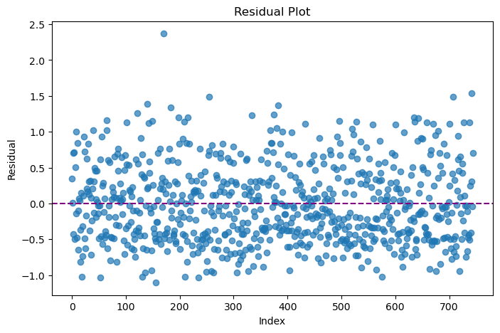
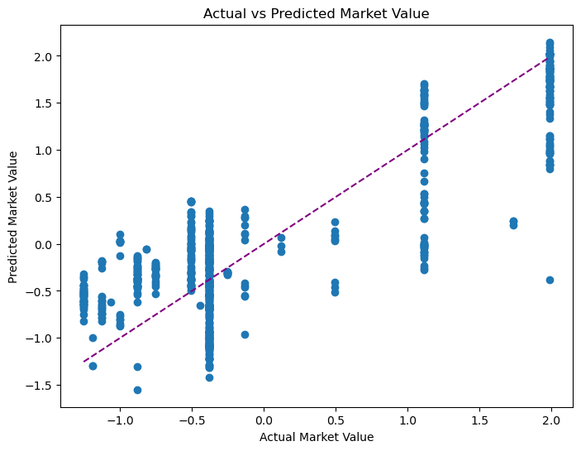
Residual plot & Actual vs Predicted Market value :
Residual Plot :
The dots are spread randomly above and below zero. This means the model does not make mistakes in any predictable way.
In simple words, the model’s errors are random, so the predictions it gives are trustworthy.
Actual vs Predicted Market value :
Most dots are close to the diagonal line. This line shows perfect predictions.
The closer the dots are to the line, the better the model.
Overall, Both plots show the model fits the data well and gives fair, unbiased predictions for market value.

Slide 15
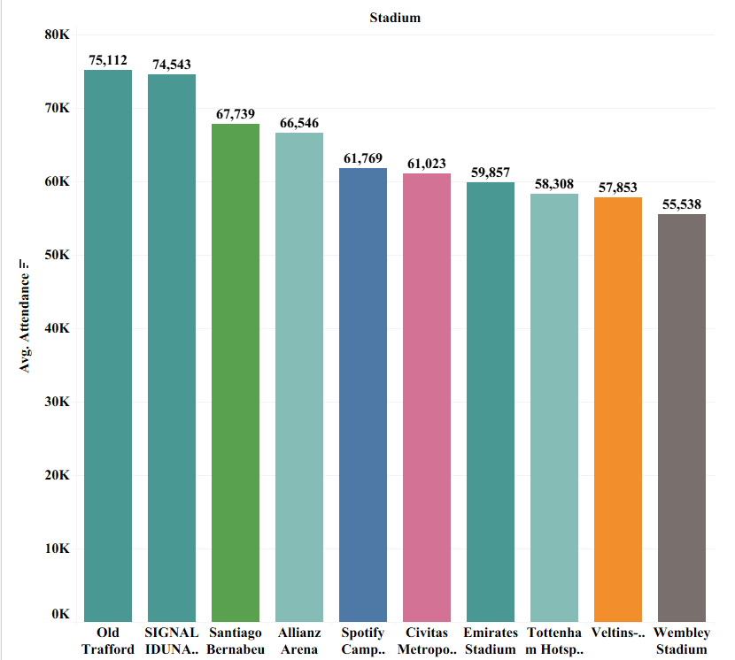
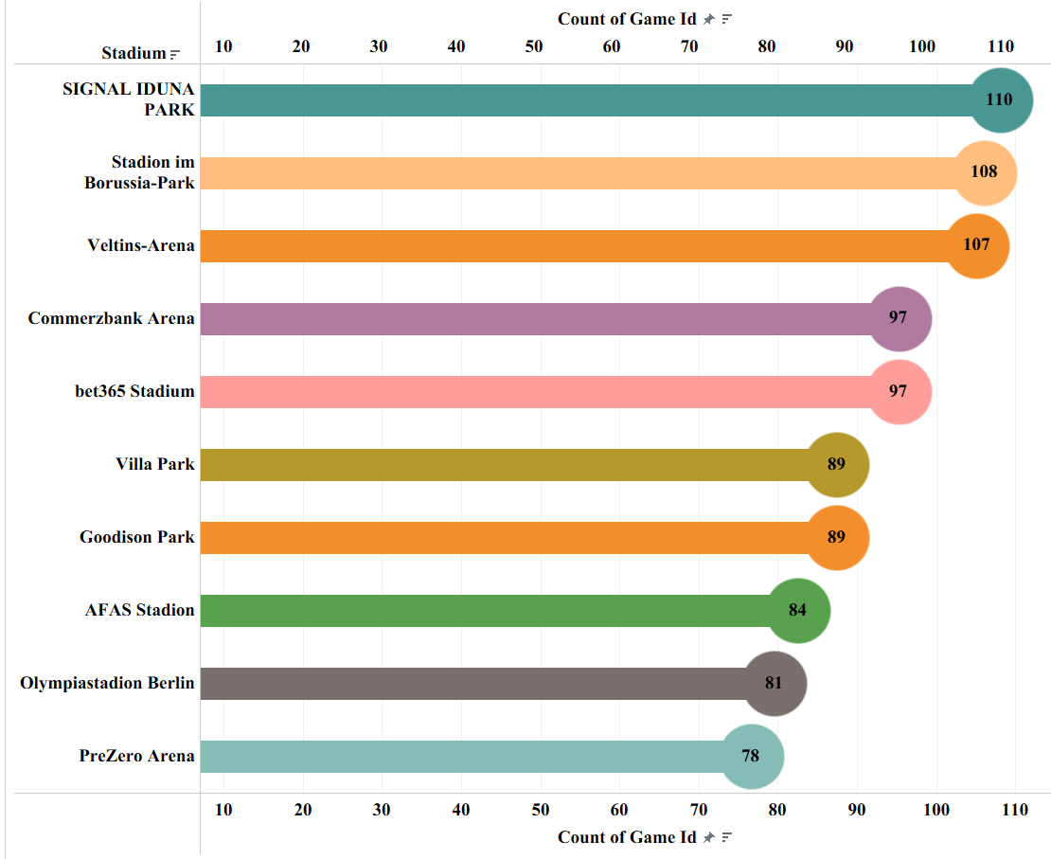
3
Attendance
& Stadium Analysis
Descriptive Analysis
Average Attendance by Stadium
Stadiums Ranked by Total Matches Hosted
Interpretation :
This chart highlights the stadiums with the highest average attendance, showing which stadiums are best at drawing large crowds for football matches. Stadiums like Old Trafford and Signal Iduna Park have the biggest average crowds in football matches ,bringing in over 74,000 to 75,000 people per game.
Interpretation :
That chart shows the count of matches hosted by each Stadium. Signal Iduna Park leads by hosting 110 matches, with other popular stadiums like Borussia-Park and Veltins-Arena close behind. Stadiums that regularly host many games play a key role in the football calendar and are important for both clubs and fans.
Notes:
Descriptive Analysis :
Summarized the Data : Found basic numbers like totals, averages, highest and lowest values to quickly understand key points (like how many players, goals, clubs, market values, etc.).
Showed Everything in Charts : Created clear visuals - like bar charts, pie charts, and line graphs - so patterns and differences are easy to spot for everyone.
Looked for Patterns : Checked which players or clubs do best and when, spotted any unusual trends or standout seasons, and saw where there are sudden spikes or drops.
Made it Useful for Decisions : These summaries and charts help coaches, managers, or fans make smarter choices—for example, focusing on successful players, strong clubs, or areas needing improvement.
Compared Different Groups: Broke down the data by categories (like player position, club, season, or competition) to see how different groups perform and discover what makes some better than others.
Conclusion :
Descriptive analysis is the first and most important step for finding value in data, as it helps everyone see what is really happening.

Slide 16
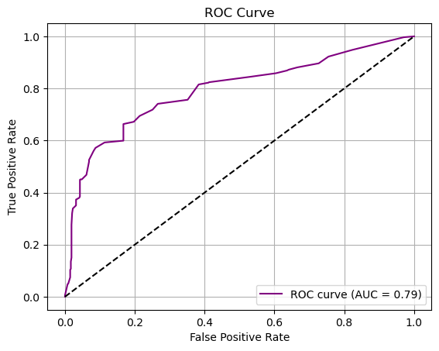
Logistic Regression Model for Attendance Prediction
Based on correlation analysis and model testing, the top features for predicting Attendance are:
    Highest market value in euro
    Market value in euro
Building and Testing the Predictive Model :
  Model Performance:
    Accuracy : 0.72
    Precision : 0.69
    Recall : 0.81
    F1 Score: 0.75
Classification Report:
 | F1 Score | Recall | Precision
Low | 0.75 | 0.82 | 0.70
High | 0.68 | 0.62 | 0.76

Slide 17
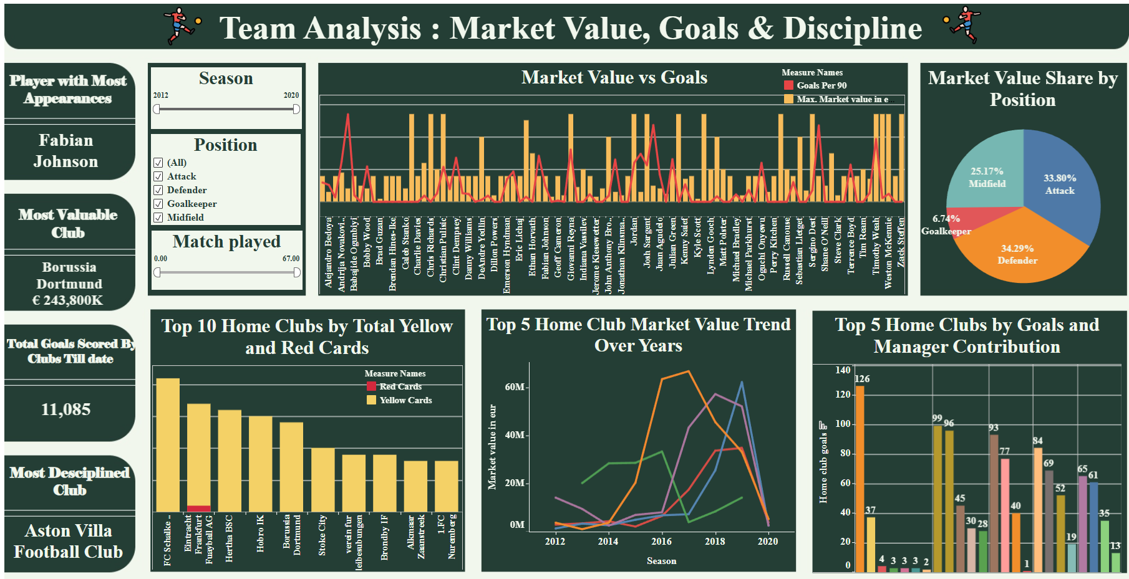
Click Here

Slide 18
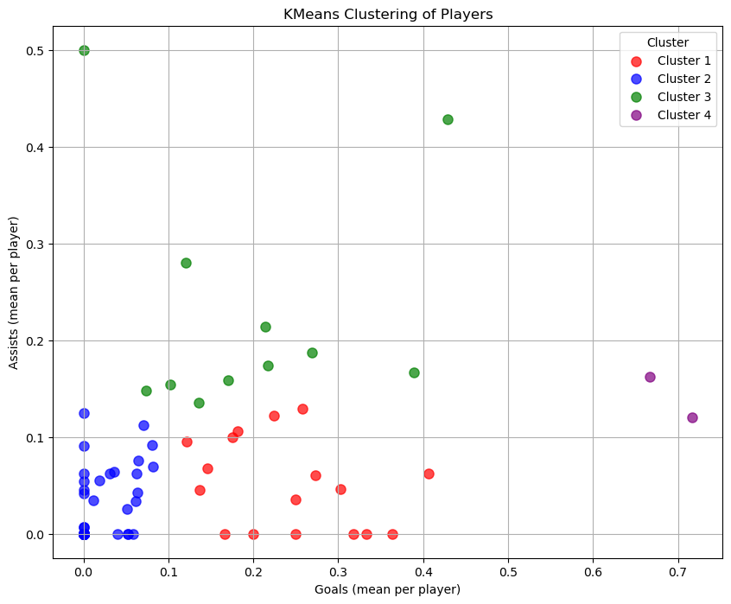
5
K-means clustering
Player Attributes
&
Demographics
Selected features
Age
Height
Weight
Passes
Goals
Assists
Cluster Number | Description
1 | Moderate goal scorers with few assists
2 | Low scorers with low assists, possibly defensive players
3 | Moderate goal scorers with higher assists, supporting Attacking Players
4 | High goal scorers and moderate assisters, primary attackers
Notes:
What does "cluster" mean in K-means clustering?
A "cluster" is just a group of similar things—here, it means grouping players who have similar statistics and physical attributes (like age, height, goals, etc.). You don’t need to decide the groups ahead of time. The computer finds natural groupings based on the data, so players in the same cluster are more alike to each other than to those in other clusters.​
What does the y-axis show?
The y-axis in the elbow curve shows the "Within-Cluster Sum of Squares" (WCSS). This is a measure of how close the players in each group are to the center of their group. A lower value means the points (players) in a group are closer together and more similar.​
Why do we choose 4 clusters?
When you look at the elbow curve, you see the WCSS drops fast as you add clusters—but after 4, the improvement slows down. That "elbow" at 4 means you’ve picked a number of groups that keeps the clusters meaningful and clear, without making things too complicated. The computer is saying 4 types of player profiles is the best balance for your data.​​
Why use K-means clustering for player demographics?
K-means lets you automatically sort players into groups based on similarities in their data. This helps coaches, analysts, or recruiters quickly see what kinds of players there are, build strategies, compare groups, or make fair decisions. It's a tool to help make sense of a lot of information by showing natural categories within your team or league.

Slide 19
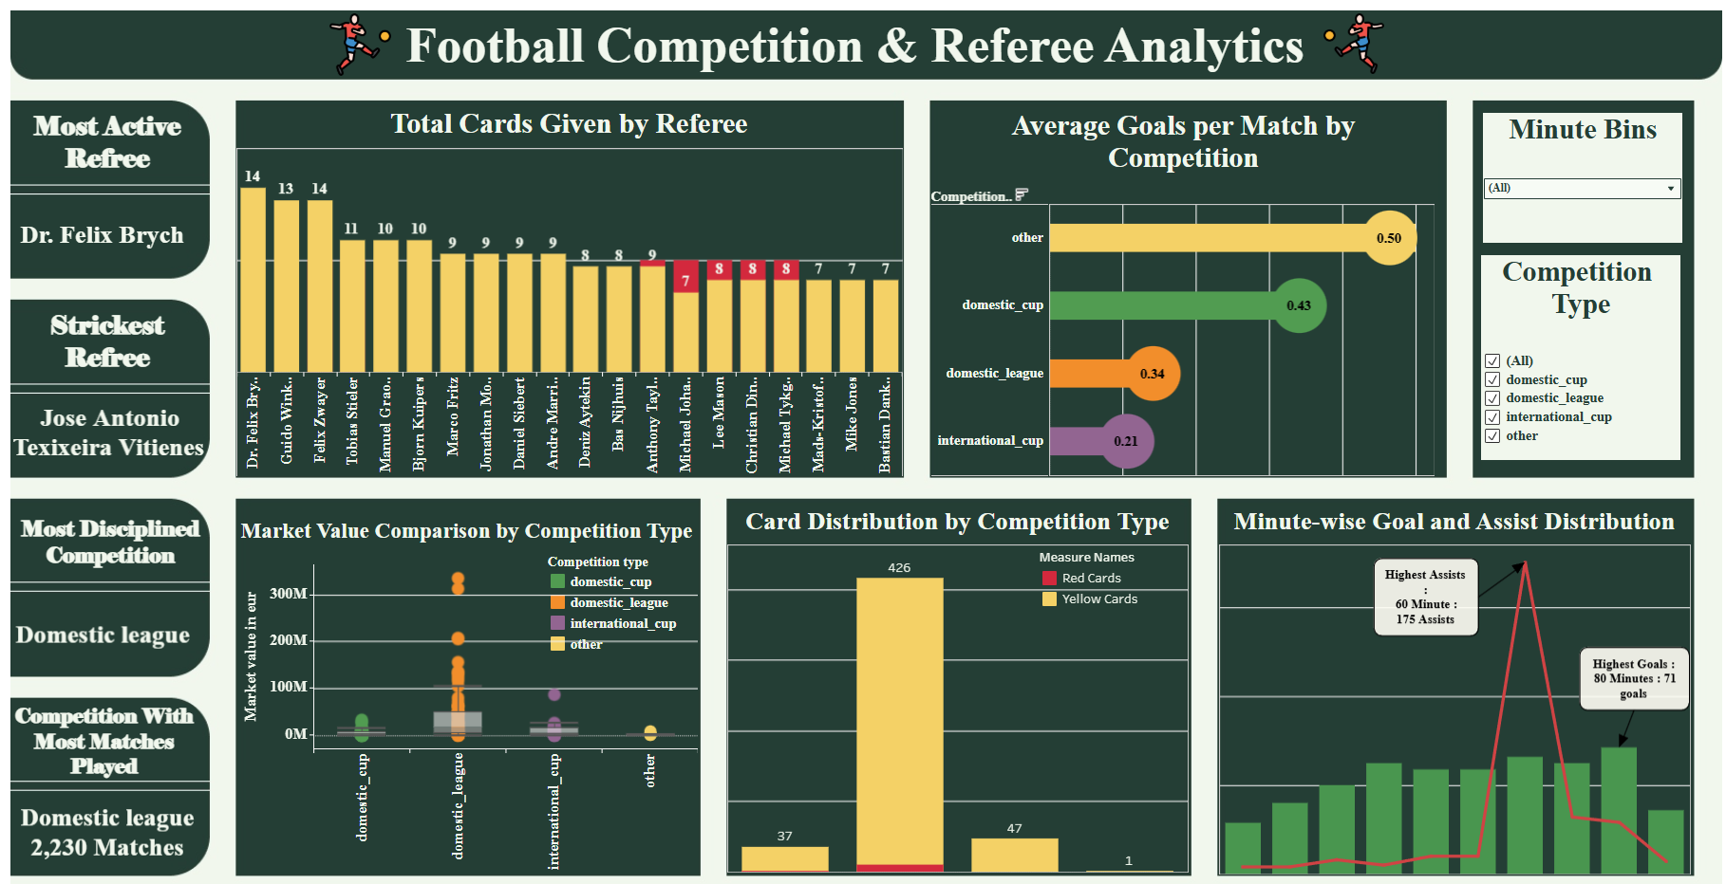
Click Here

Slide 20
Summary :
Goal Efficiency: Aron Johannsson led all players in goals per 90 minutes, while Christian Pulisic and Jozy Altidore topped the charts for both goals and assists.
Player Value Modeling: Regression analysis showed that features like highest market value in euro predict player value.
Team Insights: Borussia Dortmund stood out as the most valuable club, and Signal Iduna Park hosted the largest number of matches in the dataset.
Attendance Leaders: Old Trafford and Signal Iduna Park recorded the highest average attendance, attracting crowds of over 74,000 fans per game.
Referee Analytics: Dr. Felix Brych was the most active referee, and Jose Antonio Teixeira Vitienes issued the most cards, impacting match discipline and outcomes.
Competition Comparison: Domestic leagues accounted for the most matches and goals, with visible differences in event frequency by competition type.
Player Grouping: K-means clustering (elbow method) found that splitting players into 4 groups based on attributes and demographics best represents the diversity in the data.

Slide 21
Conclusion :
This project successfully analyzed football player performance, market value, referee behavior, and stadium attendance using statistical methods and predictive modeling. Insights revealed that players like Aron Johannsson and Christian Pulisic excel in both scoring and assists, while clubs such as Borussia Dortmund and stadiums like Signal Iduna Park and Old Trafford lead in performance and fan engagement. With reliable and effective clustering, the analysis provides meaningful, data-driven insights that can help coaches, analysts, and management make smarter tactical, financial, and strategic decisions for future seasons.

Slide 22
Limitations :
Some important match data like wins, losses, and draws were missing, limiting outcome analysis.
Small errors occurred in stadium prediction model, affecting some analyses.
Referee data lacked timing details of fouls and cards, reducing depth of discipline insights.
The models perform well overall but have less accuracy on rare events like very high goal counts.
Recommendation :
We can add More match data which can improve the performance of models
Focus on recruiting players who score efficiently at lower market costs, like Aron Johannsson.
Update models regularly with new season data for consistent predictive power.
Include referee event timings and decision impact metrics to enhance match discipline analysis.
Notes:
Recommendations/Action Steps: Add a slide suggesting 2-3 next actions for coaches/managers based on your findings (for example, how to use clusters for scouting, how to respond to strict refereeing, etc).
Data Limitations: Briefly mention any data gaps (e.g., missing seasons, injuries, player transfers) or assumptions, to show critical thinking.
Visualization Variety: Add at least one interactive or more dynamic visualization (e.g., heatmap, animation, or a Tableau dashboard GIF/screenshot) for extra engagement and to demonstrate your BI/dashboard skills.
Model Explainability: For regression or clusters, a small “feature importance” graphic or simple table could explain why certain attributes matter most.
Future Work: One bullet on expanding to more leagues, adding injury/time series analysis, or deploying dashboards for club use.

Slide 23
Thank You
Notes:
Recommendations/Action Steps: Add a slide suggesting 2-3 next actions for coaches/managers based on your findings (for example, how to use clusters for scouting, how to respond to strict refereeing, etc).
Data Limitations: Briefly mention any data gaps (e.g., missing seasons, injuries, player transfers) or assumptions, to show critical thinking.
Visualization Variety: Add at least one interactive or more dynamic visualization (e.g., heatmap, animation, or a Tableau dashboard GIF/screenshot) for extra engagement and to demonstrate your BI/dashboard skills.
Model Explainability: For regression or clusters, a small “feature importance” graphic or simple table could explain why certain attributes matter most.
Future Work: One bullet on expanding to more leagues, adding injury/time series analysis, or deploying dashboards for club use.

